Slide 1
TAS152
LECTURE 8
TOPIC 2
ETHICS IN THE INFORMATION SOCIETY
2.1 PRINCIPLES: ETHICAL VALUES

Slide 2
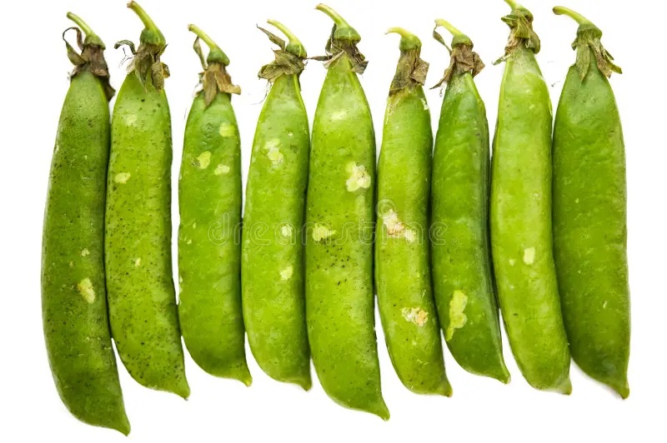
TOPIC 2 – ETHICS IN THE INFORMATION SOCIETY
Nine core subtopics (9 Ps)
Principles: Ethical values
Participation: Access to knowledge for all
People: Community, identity, gender, generation and education
Profession: Ethics of information professionals
Privacy: Dignity, data mining and security
Piracy: Intellectual property and cybercrime
Protection: Children and young people
Power: Economic power of technology, media and consumers
Policy: The ethics of regulation and freedom

Slide 3
TOPIC 1 - PRINCIPLES
Global ethics versus contextual ethics
Global ethics?
Values that apply to all cultures and ideologies, political and economic systems.
Creating an environment that is supportive of human rights.
Recognition of human dignity
Personal freedom
Right to justice
Contextual ethics?
Specialized to the impact of individuals and institutions on social structures within local cultural, religious, economic or political contexts.
Rules enforced in communities (i.e. schools) or ethical values specified by different religions.

Slide 4
TOPIC 1 - PRINCIPLES
How can ethics be abused?
Global ethics - powerful nations wanting to dominate weaker communities.
The UN has been met with criticism in the past: https://en.wikipedia.org/wiki/Criticism_of_the_United_Nations
Contextual ethics - hold on to local political power.
The Wilgenhof scandal at Stellenbosch University
Both are influenced by geo-political and economic trends, new technologies, shocks, crises, wars, natural disasters etc.

Slide 5
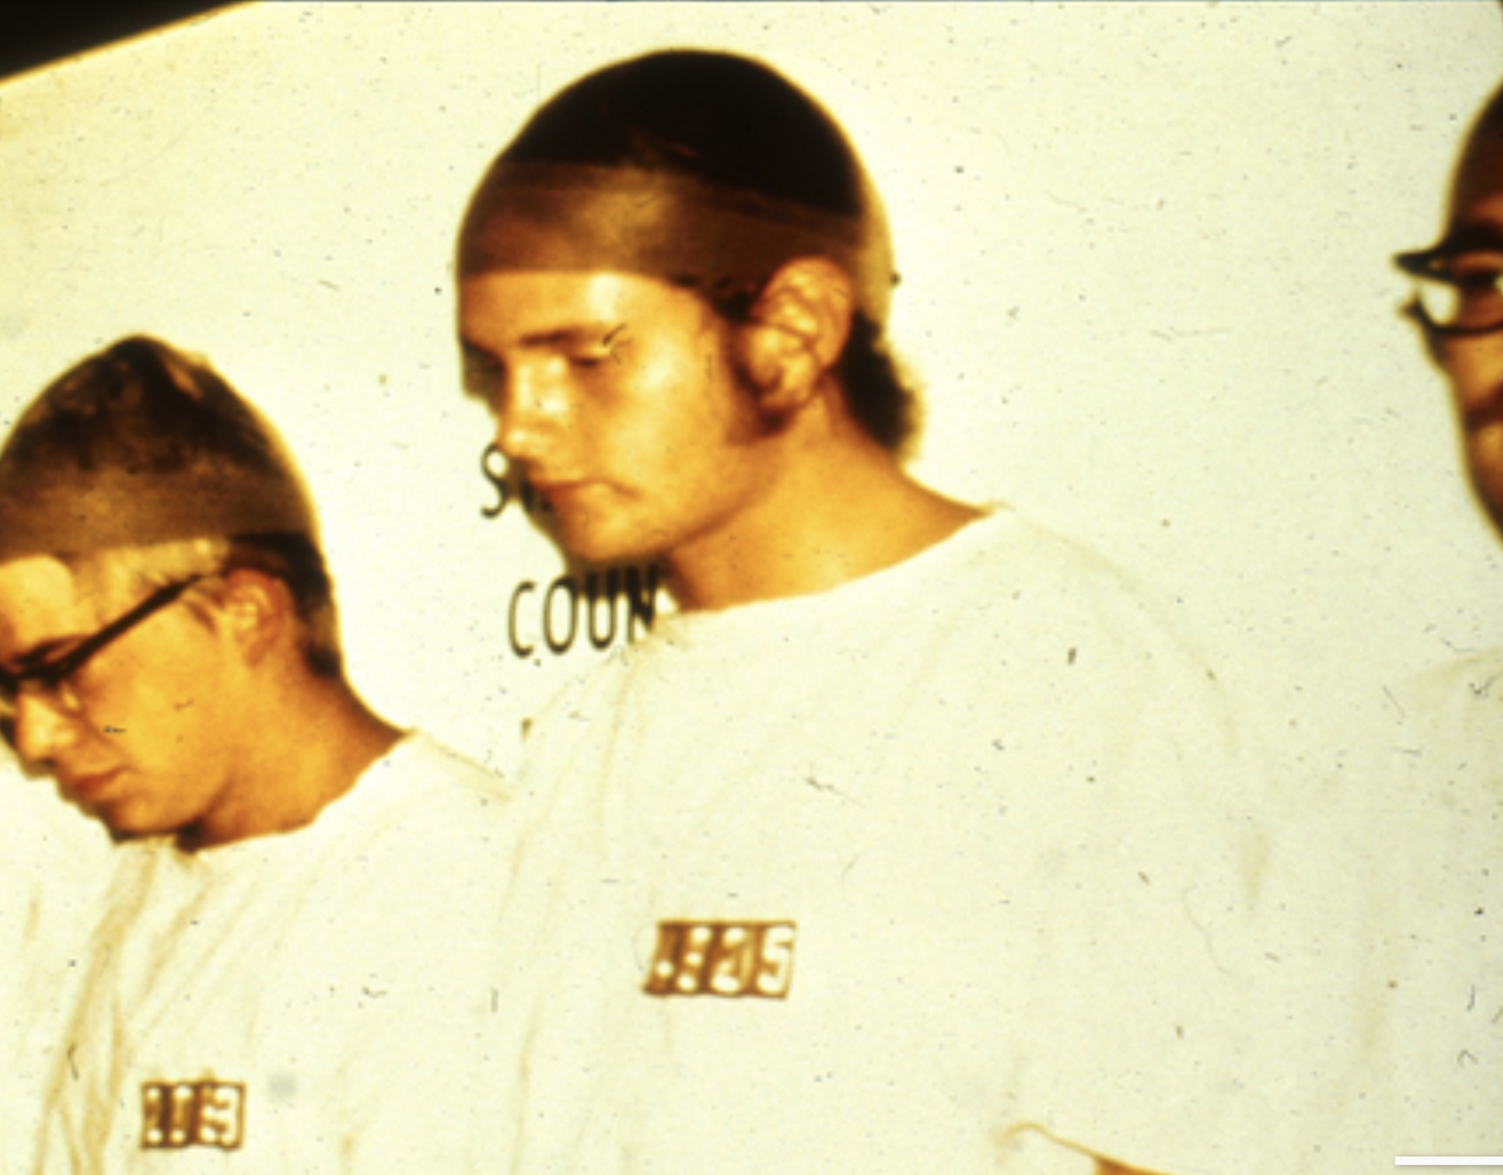
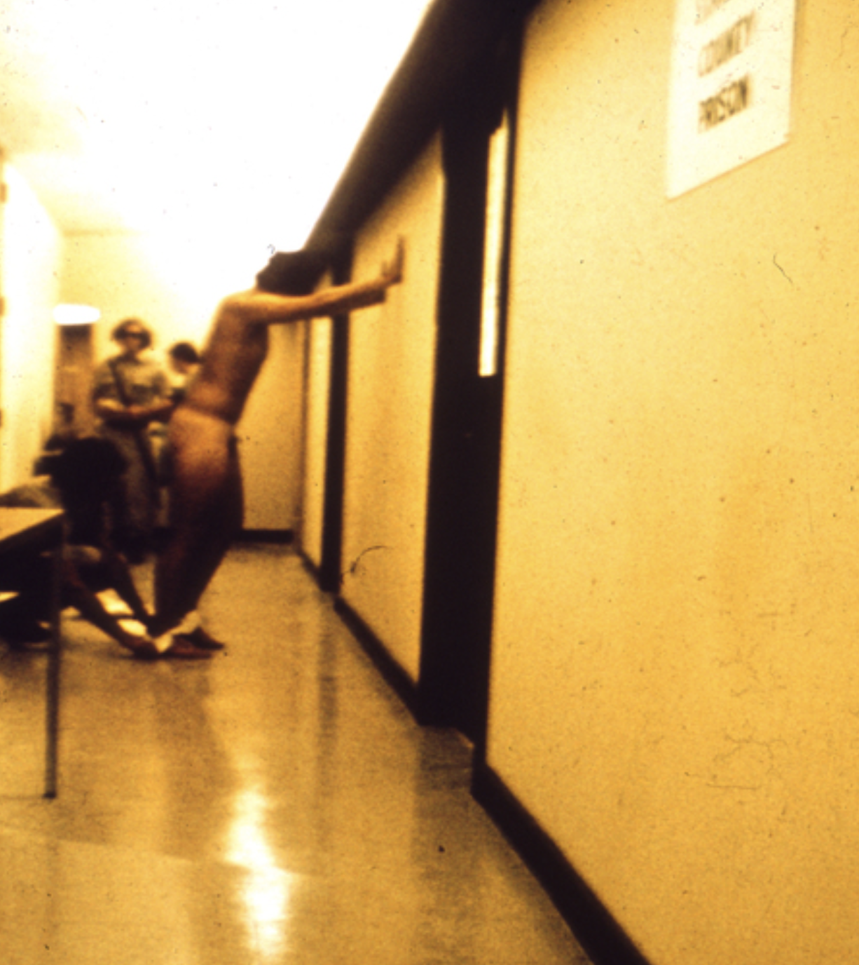
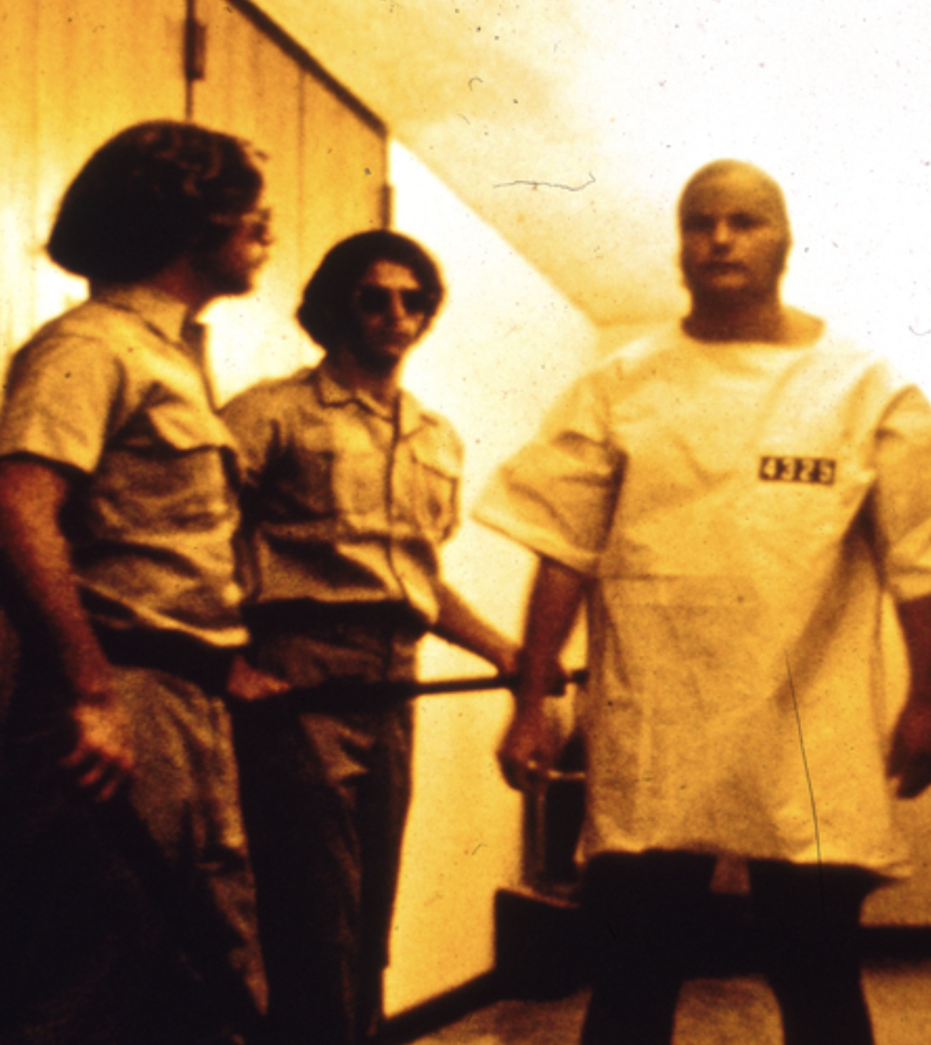
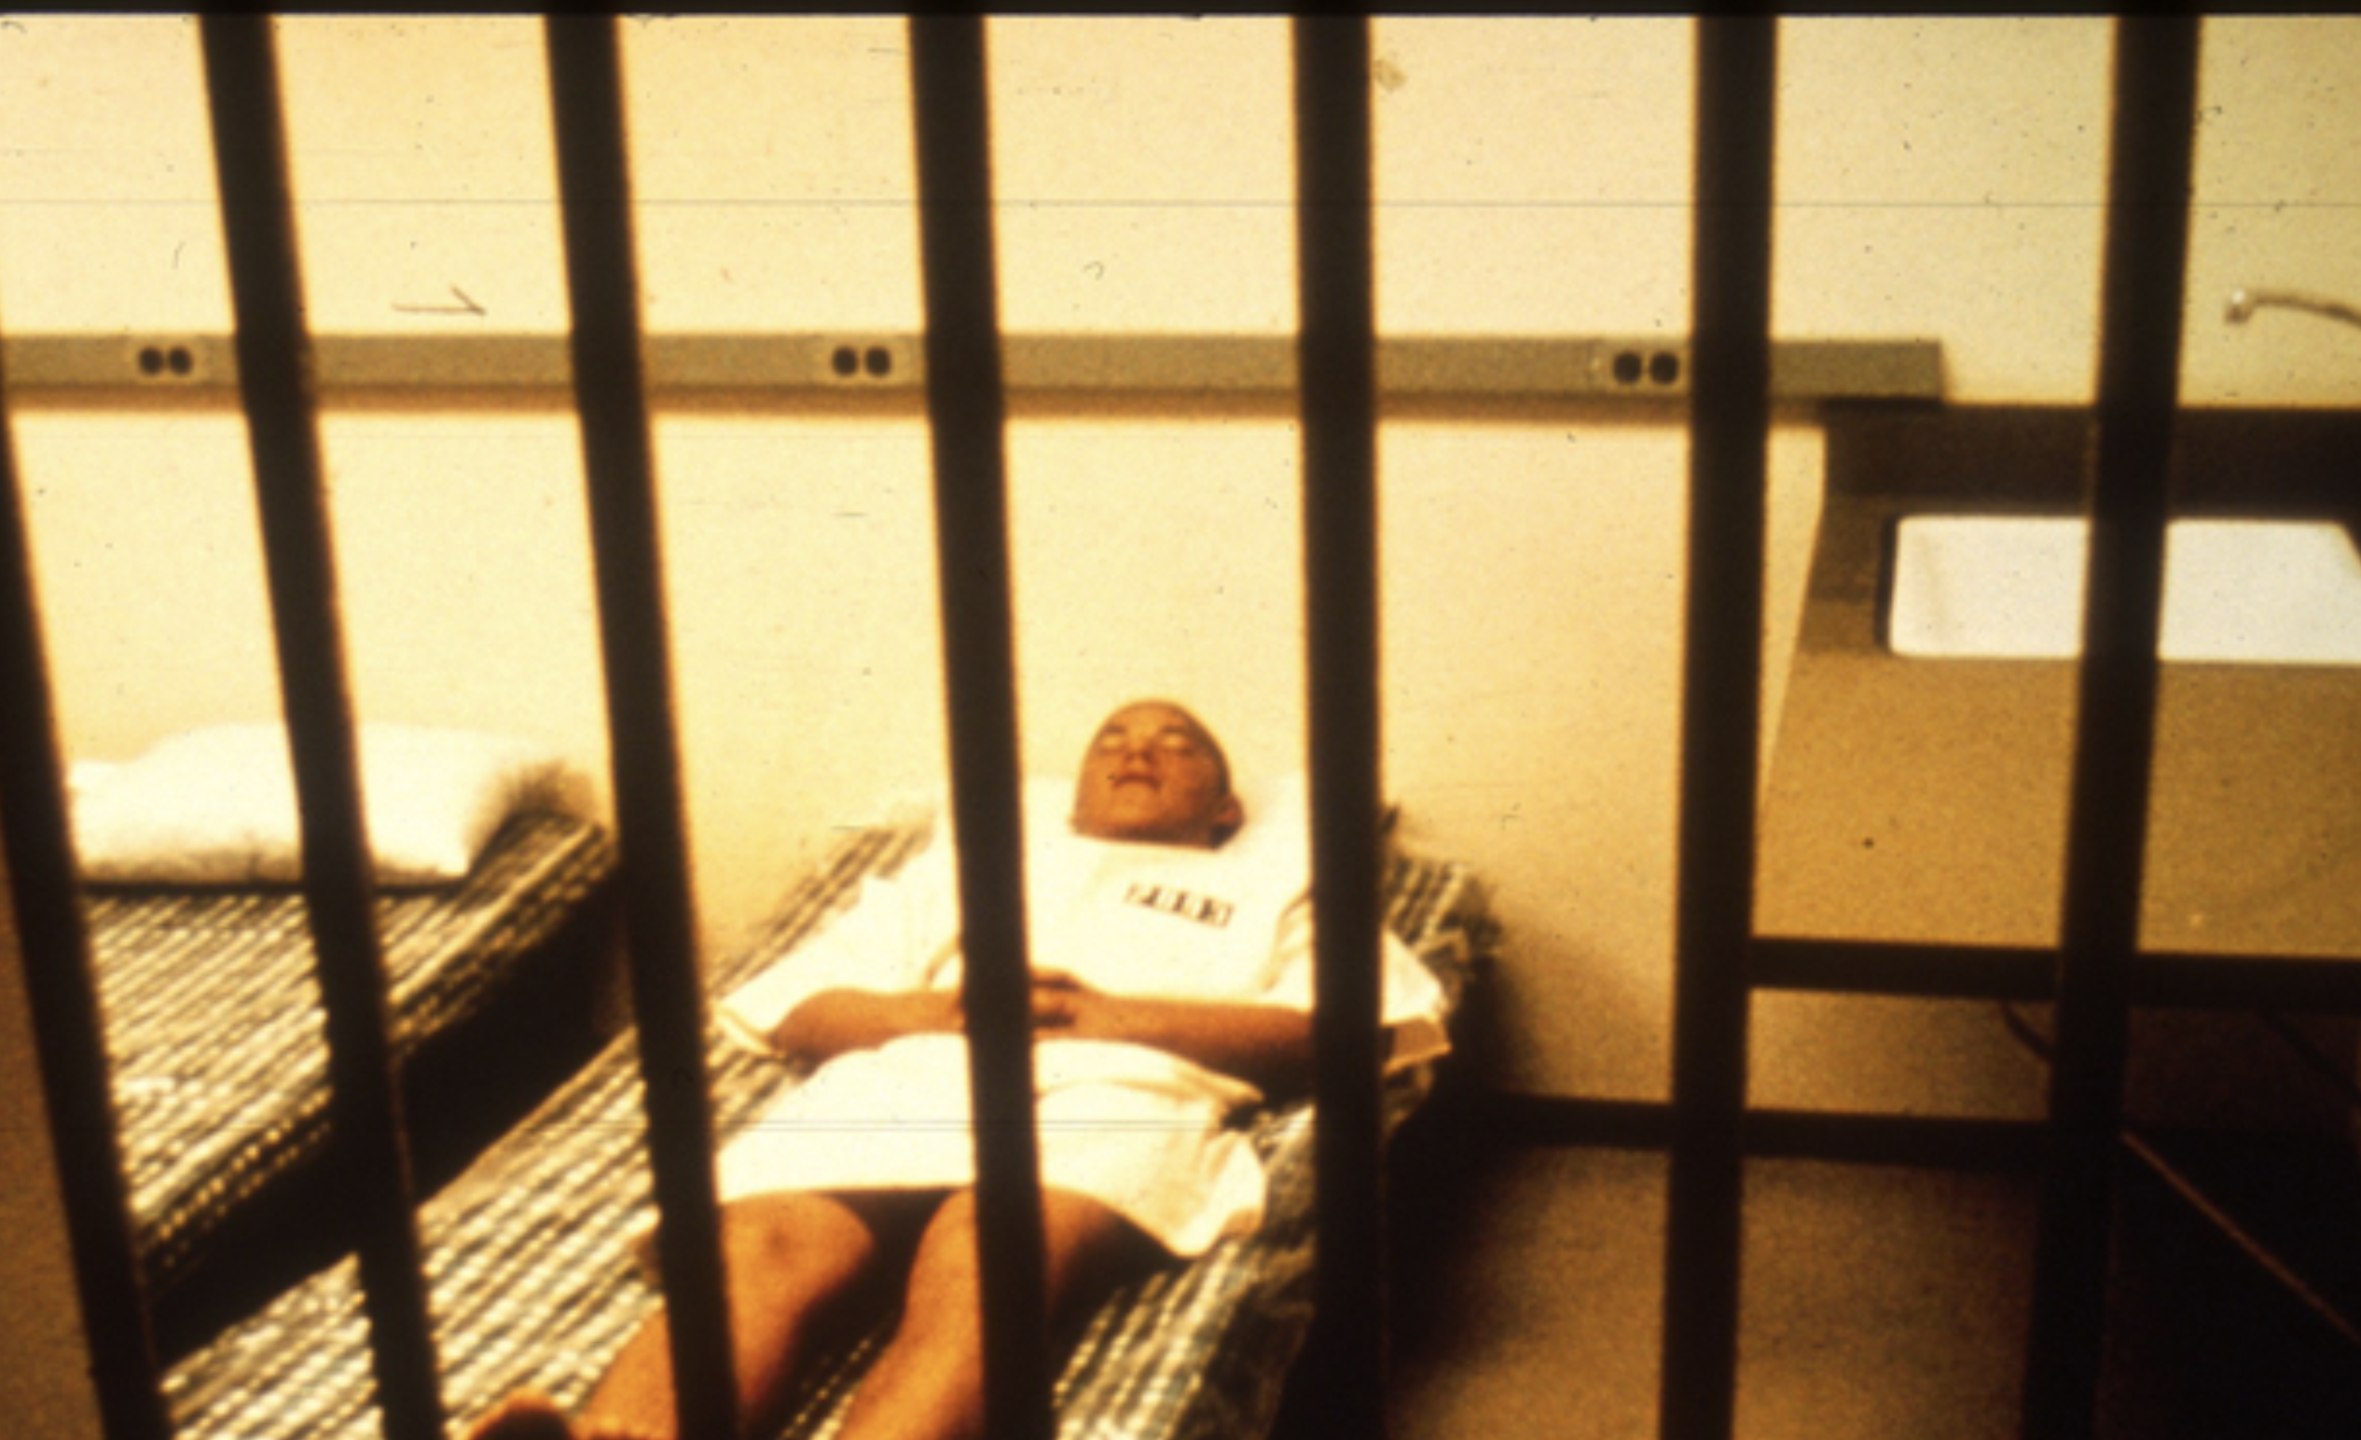
THE STANFORD PRISON EXPERIMENT
The key to enabling people to be as moral as possible is designing an ethical environment that makes such behaviour easy, automatic and habitual.
24 college students were recruited for a psychological study of prison life.
Half were prisoners, half were to be guards.
The prisoners, were arrested, dressed in prison uniforms, strip searched, deloused, locked behind bars.
They wore chains around their ankles
A stocking cap on their heads
They were referred to by prisoner number

Slide 6
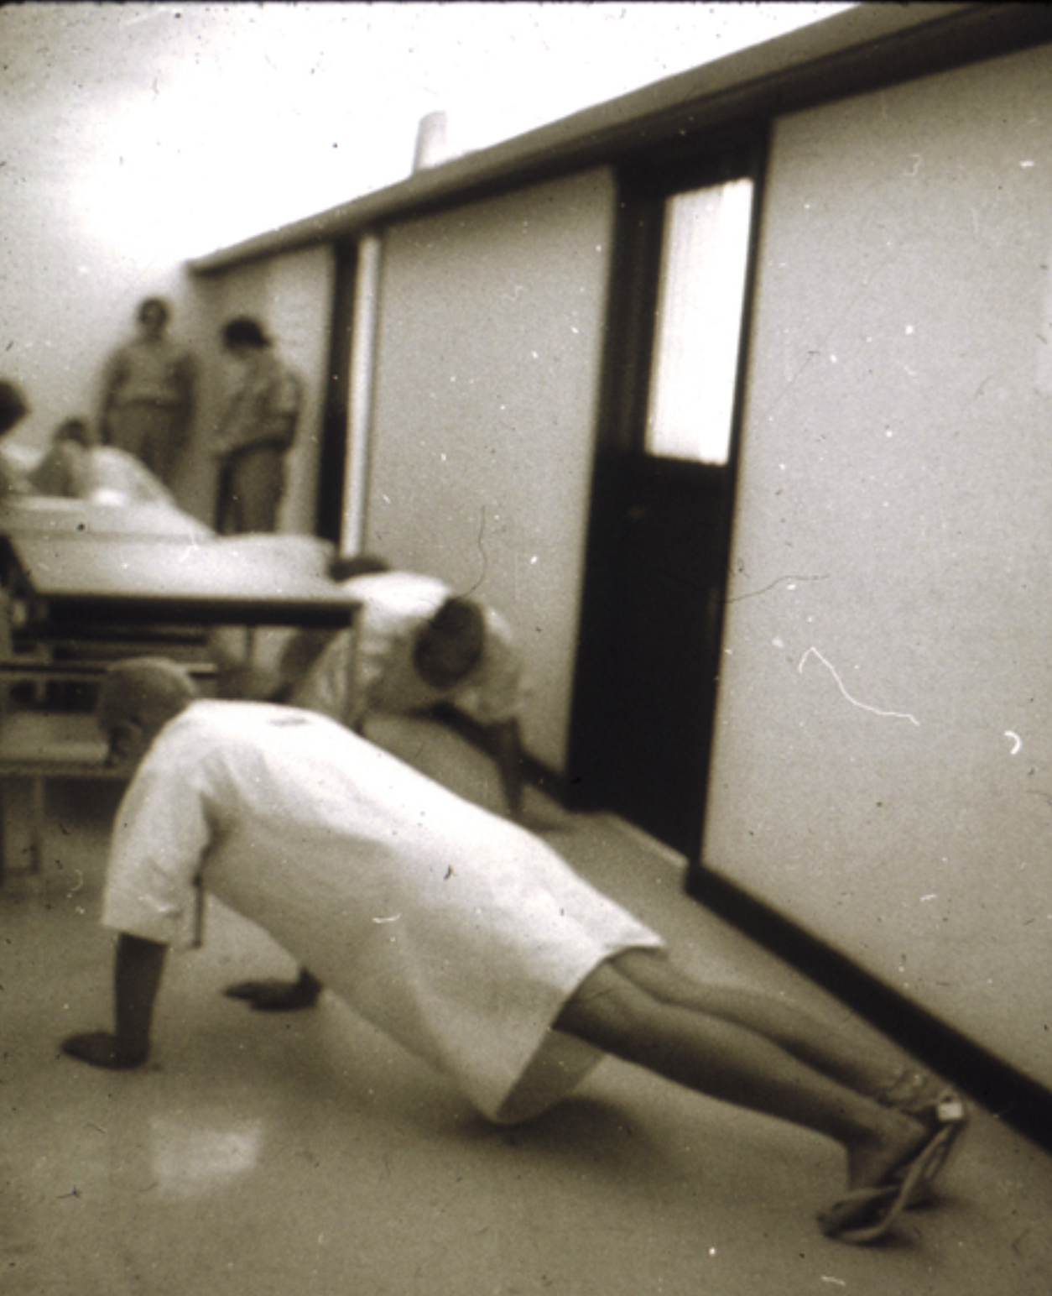
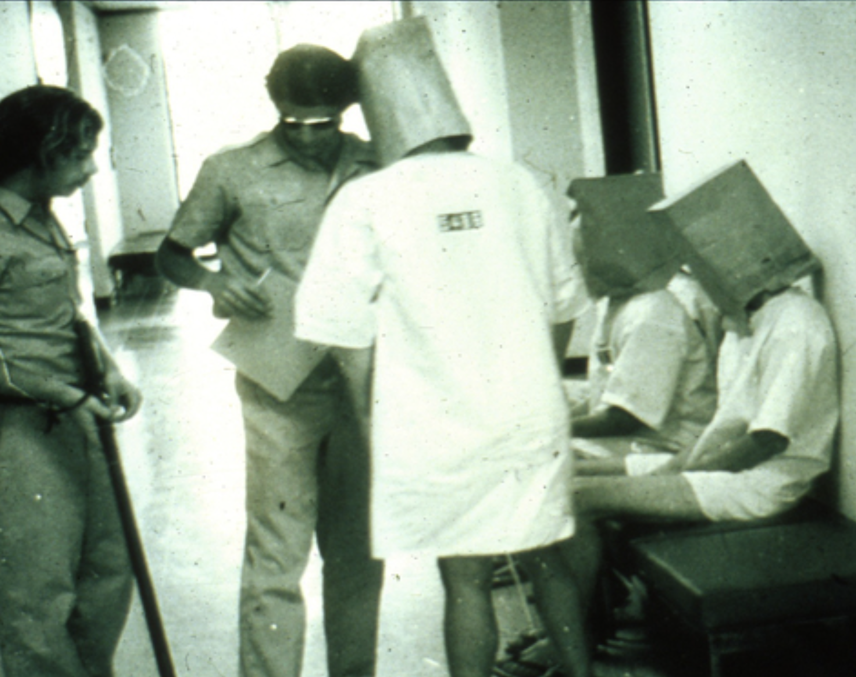
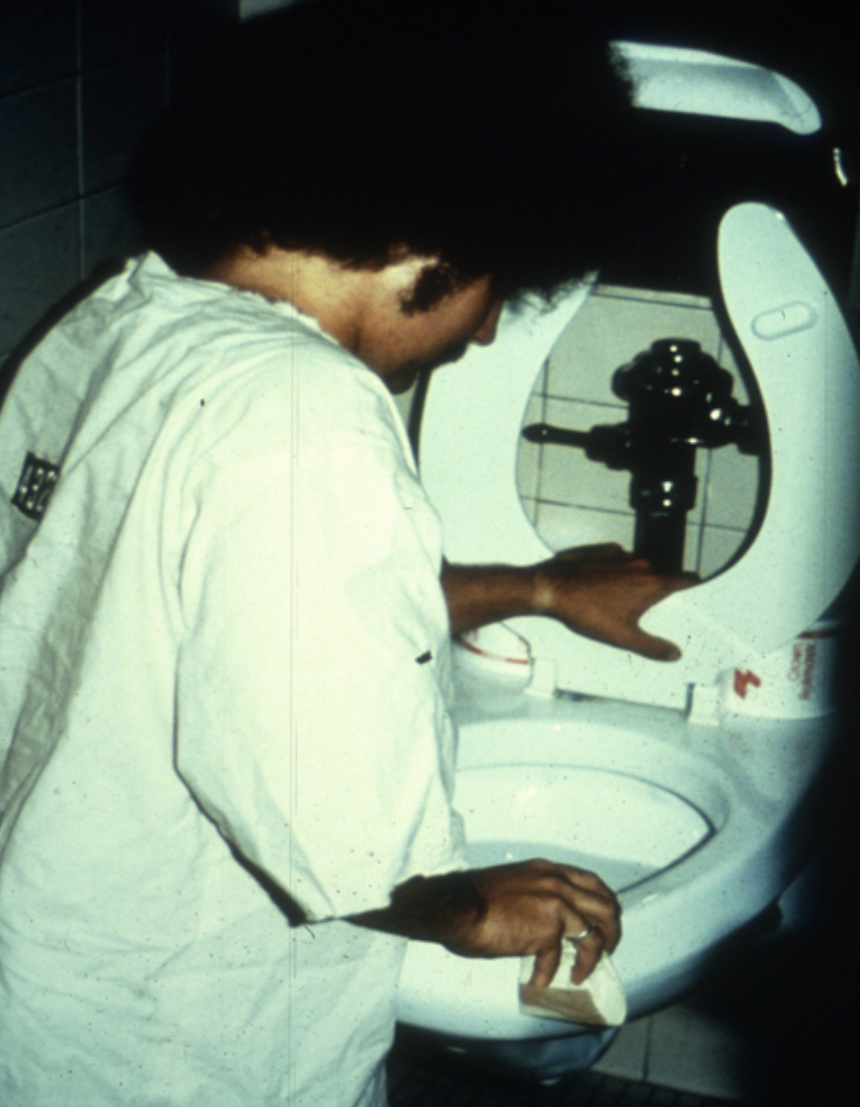
THE STANFORD PRISON EXPERIMENT
The guards were given no instruction
The guards were free to do as they pleased.
Initially punishments were benign, prisoners were woken up regularly, fed very little food and had to drop and do pushups when asked.
Put into solitary confinement for hours
Spray prisoners with fire-extinguishers
Guards began to remove the prisoners' mattresses
Force the prisoners to relieve themselves in buckets they had to sleep next to
Force them to clean toilets with their bare hands
Photos: https://www.prisonexp.org/gallery

Slide 7
THE STANFORD PRISON EXPERIMENT
The experiment lasted a total of six days.
None of the guards were ever late for a shift.
Two prisoners had to leave the experiment early due to some form of mental breakdown.

Slide 8
HOW TO ENCOURAGE ETHICAL ACTIVITIES
Draw attention to moral principles.
Provide examples of ethical behaviour
Remove barriers to ethical behaviour.

